Slide 1
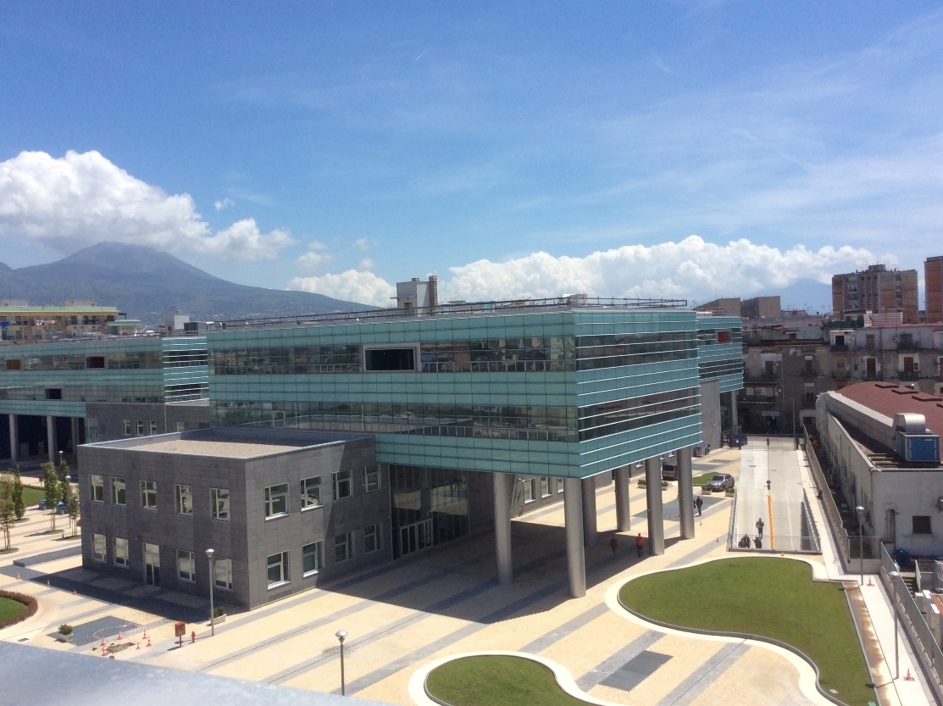


A Resource Allocation Technique for VANETs Inspired to the Banker’s Algorithm
Presentation for the 17-th International Conference on P2P, Parallel, Grid, Cloud and Internet Computing.
Biagio Scotto di Covella - b.scottodicovella@studenti.unina.it
Erasmo Prosciutto – e.prosciutto@studenti.unina.it
Silvia Stranieri – silvia.stranieri@unina.it
Walter Balzano – wbalzano@unina.it
University of Naples: Federico II
DIETI - Department of Electrical Engineering and Information Technology
A Resource Allocation Technique for VANETs Inspired to the Banker’s Algorithm, 3PGCIC-2022 Conference, October 28 1/16

Slide 2

Key Words:
Introduction
The Problem
Goal
The Banker’s Algorithm
Flowchart Isomorphism
VANETs Banker’s Algorithm
Pre-conditions acquisition
Simulation
Secure state verification
Conclusions
VANETs
Traffic Congestion
Resource Allocation
Banker's Algorithm
A Resource Allocation Technique for VANETs Inspired to the Banker’s Algorithm, 3PGCIC-2022 conference, October 28, 2/16

Slide 3
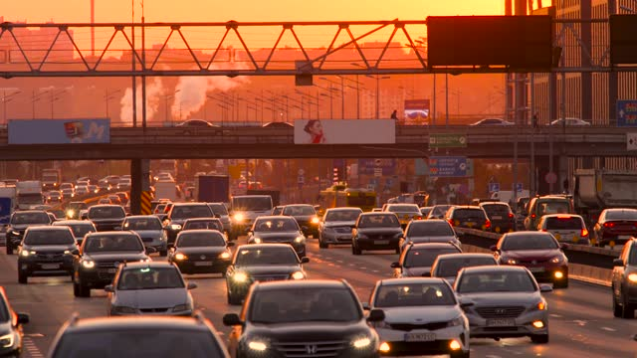
The Problem
Introduction
The Problem
Goals
The Banker’s Algorithm
Flowchart Isomorphism
VANETs Banker’s Algorithm
Pre-conditions acquisition
Simulation
Secure state verification
Conclusions
The increase in population since 1985 and consequently the increase in the number of vehicles on our roads
Working on new models and methodologies in order to reduce the problem, since it is bound to grow
Several European cities have a mileage increased over the 50% due to the traffic congestion. In such a scenario, vehicular ad hoc networks, VANETs for short, play an important role.
A Resource Allocation Technique for VANETs Inspired to the Banker’s Algorithm, 3PGCIC-2022 conference, October 28, 3/16

Slide 4
Goals
Introduction
The Problem
Goals
The Banker’s Algorithm
Flowchart Isomorphism
VANETs Banker’s Algorithm
Pre-conditions acquisition
Simulation
Secure state verification
Conclusions
Revisit the banker's algorithm used for operating systems and relate it back to the case study
Provide an algorithm to reduce the traffic congestion in VANETs
Optimize the roads occupation and improve the viability quality.
A Resource Allocation Technique for VANETs Inspired to the Banker’s Algorithm, 3PGCIC-2022 conference, October 28, 4/16

Slide 5

The Banker’s Algorithm: Core Concepts
Introduction
The Problem
Goals
The Banker’s Algorithm
Flowchart Isomorphism
VANETs Banker’s Algorithm
Pre-conditions acquisition
Simulation
Secure state verification
Conclusions
When two different processes ask for the same request at the same time, they can block each other waiting for the resource to be release
Inspired by the loan model used between the banks and the customers to guarantee not to expire the available economic resources.
A Resource Allocation Technique for VANETs Inspired to the Banker’s Algorithm, 3PGCIC-2022 conference, October 28, 5/16

Slide 6
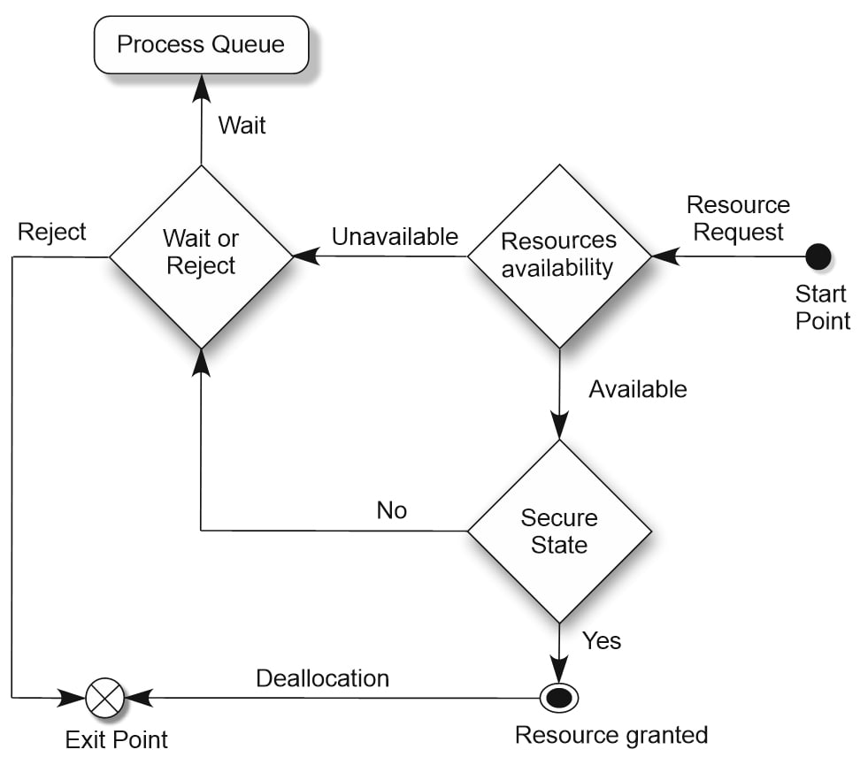
The Banker’s Algorithm: Statements
Introduction
The Problem
Goals
The Banker’s Algorithm
Flowchart Isomorphism
VANETs Banker’s Algorithm
Pre-conditions acquisition
Simulation
Secure state verification
Conclusions
Resources Availability
Secure State
Wait or Reject
Process Queue
Resource Granted
A Resource Allocation Technique for VANETs Inspired to the Banker’s Algorithm, 3PGCIC-2022 conference, October 28, 6/16

Slide 7
The Banker’s Algorithm: Type of Paths
Introduction
The Problem
Goals
The Banker’s Algorithm
Flowchart Isomorphism
VANETs Banker’s Algorithm
Pre-conditions acquisition
Simulation
Secure state verification
Conclusions
1) Granted Resource Path: ResourceRequest → Available → Yes → Deallocation
2) Non-Granted Resource Path: ResourceRequest → Unavailable → Reject
3) Waiting-Queue Path: ResourceRequest → Unavailable → Wait
A Resource Allocation Technique for VANETs Inspired to the Banker’s Algorithm, 3PGCIC-2022 conference, October 28 7/16

Slide 8
Isomorphism with the traffic congestion problem in VANETs
Introduction
The Problem
Goals
The Banker’s Algorithm
Flowchart Isomorphism
VANETs Banker’s Algorithm
Pre-conditions acquisition
Simulation
Secure state verification
Conclusions
Similarly to the resource allocation in O.S., in VANETs vehicles act like processes, and the resources are the roads.
The Banker’s algorithm can be used to optimise the traffic flow according to the requests made by the vehicles.
Some routes can be considered optimal, meaning that it has the right combination of traffic load and mileage time needed to reach the right destination
A Resource Allocation Technique for VANETs Inspired to the Banker’s Algorithm, 3PGCIC-2022 conference, October 28, 8/16

Slide 9
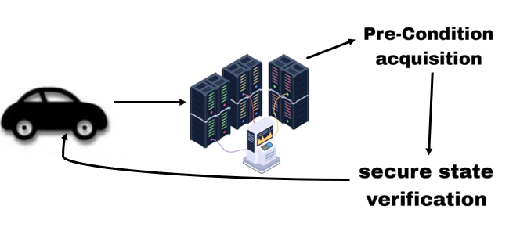
VANETs Banker’s Algorithm: Phases
Introduction
The Problem
Goals
The Banker’s Algorithm
Flowchart Isomorphism
VANETs Banker’s Algorithm
Pre-conditions acquisition
Simulation
Secure state verification
Conclusions
The revisited banker’s algorithm has two main phases:
1. Pre-conditions acquisition;
2. Secure state verification.
A Resource Allocation Technique for VANETs Inspired to the Banker’s Algorithm, 3PGCIC-2022 conference, October 28, 9/16

Slide 10
VANETs Banker’s Algorithm: Pre-conditions acquisition
Introduction
The Problem
Goals
The Banker’s Algorithm
Flowchart Isomorphism
VANETs Banker’s Algorithm
Pre-conditions acquisition
Simulation
Secure state verification
Conclusions
Let us now formalize the variables we will need to take into consideration for the first step:
1. Max. Road Capacity (M.R.C.): indicates the maximum capacity of a road to hold vehicles (we assume a road to have a max percentage of 100% capacity).
2. Max. Manageable Road Capacity (M.M.R.C.): indicates the maximum capacity of a road to hold vehicles, considering some users (that we can not map) who may not use any navigation application.
3. Max. Assignable Resource (M.A.R.): indicates the limit of maximum amount of resource that can be assigned, until the algorithm decides to redirect it to another path.
4. Road Availability (R.A.): indicates the percentage of real-time road availability.
A Resource Allocation Technique for VANETs Inspired to the Banker’s Algorithm, 3PGCIC-2022 conference, October 28, 10/16

Slide 11
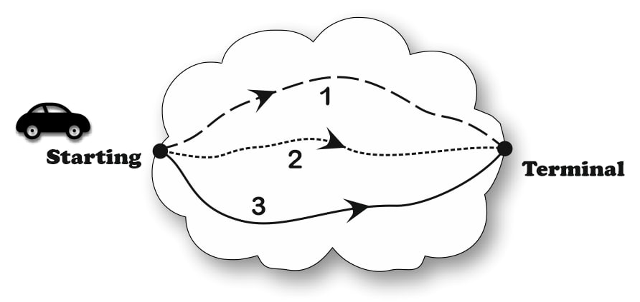
VANETs Banker’s Algorithm: Simulation
Introduction
The Problem
Goals
The Banker’s Algorithm
Flowchart Isomorphism
VANETs Banker’s Algorithm
Pre-conditions acquisition
Simulation
Secure state verification
Conclusions
VBA simulation with 3 possible routes
A Resource Allocation Technique for VANETs Inspired to the Banker’s Algorithm, 3PGCIC-2022 conference, October 28, 11/16

Slide 12
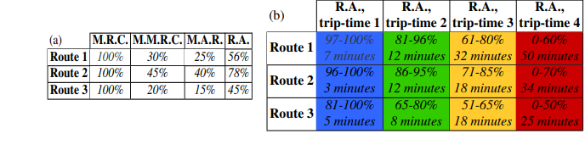
VANETs Banker’s Algorithm: Simulation
Introduction
The Problem
Goals
The Banker’s Algorithm
Flowchart Isomorphism
VANETs Banker’s Algorithm
Pre-conditions acquisition
Simulation
Secure state verification
Conclusions
VBA simulation with 3 possible routes
(a) Roads parameter’s percentage
(b) roads availability percentage with estimated travel time
A Resource Allocation Technique for VANETs Inspired to the Banker’s Algorithm, 3PGCIC-2022 conference, October 28, 12/16

Slide 13
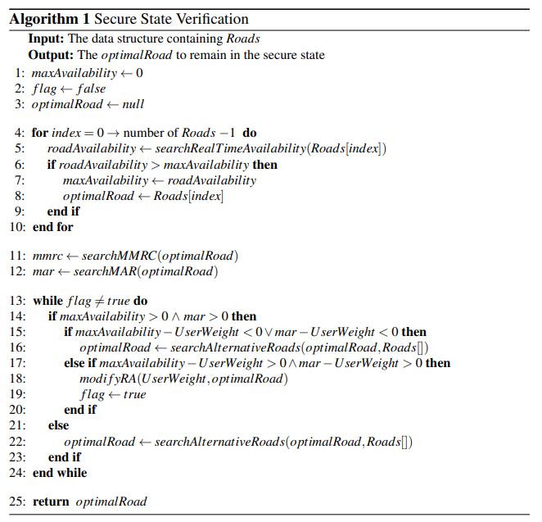
VANETs Banker’s Algorithm: Secure state verification
Introduction
The Problem
Goals
The Banker’s Algorithm
Flowchart Isomorphism
VANETs Banker’s Algorithm
Pre-conditions acquisition
Simulation
Secure state verification
Conclusions
A secure state is a state in which all the requests can be satisfied through a resource assignment leading to a correct termination of the involved processes
The algorithm checks whether, by executing a vehicle/road association, that road exceeds its maximum allowed capacity, bringing the system into an unsafe state
A Resource Allocation Technique for VANETs Inspired to the Banker’s Algorithm, 3PGCIC-2022 conference, October 28, 13/16

Slide 14
VANETs Banker’s Algorithm: Secure state verification
Introduction
The Problem
Goals
The Banker’s Algorithm
Flowchart Isomorphism
VANETs Banker’s Algorithm
Pre-conditions acquisition
Simulation
Secure state verification
Conclusions
The algorithm also relies on those auxiliary functions to
perform its functionality to the best of its ability:
searchRealTimeAvailabilty()
searchAlternativeRoads()
modifyRA()
A Resource Allocation Technique for VANETs Inspired to the Banker’s Algorithm, 3PGCIC-2022 conference, October 28, 14/16

Slide 15
VBA Cornerstones
Introduction
The Problem
Goals
The Banker’s Algorithm
Flowchart Isomorphism
VANETs Banker’s Algorithm
Pre-conditions acquisition
Simulation
Secure state verification
Conclusions
Focusing on providing the best possible optimization instead of the functionality.
As an O.S. needs optimization algorithms to perform well, in the traffic congestion problem the VBA allows users who make a request to take the best route to their desired destination.
Paths optimization for a wider audience and not only to a small portion of users.
Avoiding traffic congestion and reducing the time required to reach the desired destination.
VANET's play a main role in traffic and road congestion detection.
A Resource Allocation Technique for VANETs Inspired to the Banker’s Algorithm, 3PGCIC-2022 conference, October 28, 15/16

Slide 16
Thank you
Biagio Scotto di Covella - b.scottodicovella@studenti.unina.it
Erasmo Prosciutto – e.prosciutto@studenti.unina.it
Silvia Stranieri – silvia.stranieri@unina.it
Walter Balzano – wbalzano@unina.it
University of Naples Federico II
DIETI - Department of Electrical Engineering and Information Technology
A Resource Allocation Technique for VANETs Inspired to the Banker’s Algorithm, 3PGCIC-2022 Conference, October 28 16/16

